Slide 1
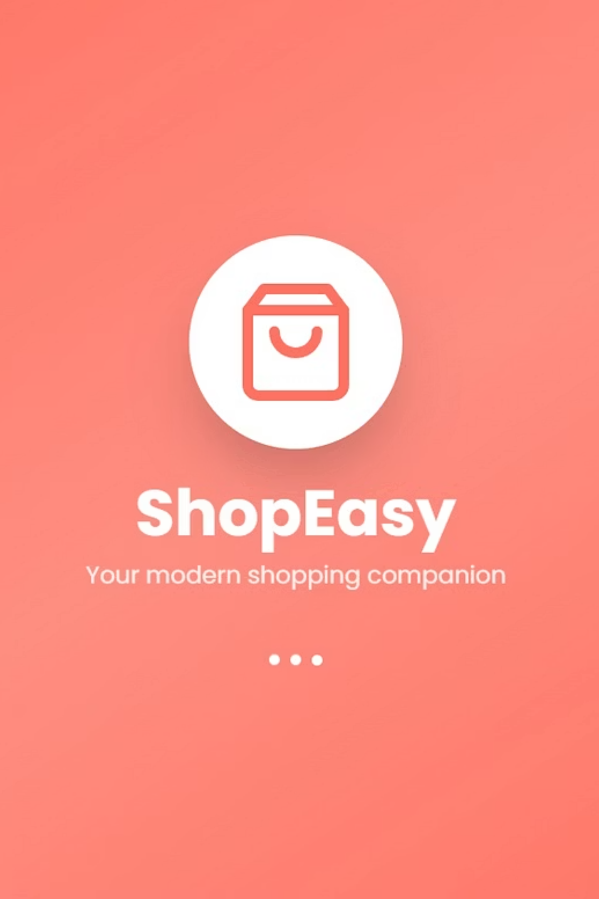
Project Overview​
Objective: Design a seamless mobile shopping experience focusing on simplicity and speed.​Duration: 6 weeks​​Tools Used: Figma, Miro, Canva, Notion, Illustrator​Platform: Mobile (Android & iOS)​Tagline: 'Style. Simplicity. Smart Shopping.'​

Slide 2

Problem StatementUsers find e-commerce apps overwhelming with too many products.​​Slow checkout and unclear filters frustrate shoppers.Trust issues with payments and delivery tracking.​Uninspired interfaces reduce engagement.​

Slide 3




Key Features and Functionality Overview
User Authentication
Smart Search
Secure login with social media integration, OTP verification, and biometric authentication for enhanced security and convenience.
AI-powered search with voice input, filters, and intelligent suggestions that understand user intent and shopping patterns.
Push Notifications
Wishlist Management
Timely alerts for offers, order updates, and personalised recommendations that drive engagement and repeat purchases.
Save favourite items, create multiple wishlists, and receive price drop alerts to enhance the shopping experience.
Customer Support
Social Integration
24/7 chat support, FAQ section, and easy return/refund management ensuring customer satisfaction at every touchpoint.
Share products, write reviews, and connect with friends to create a community-driven shopping experience.

Slide 4
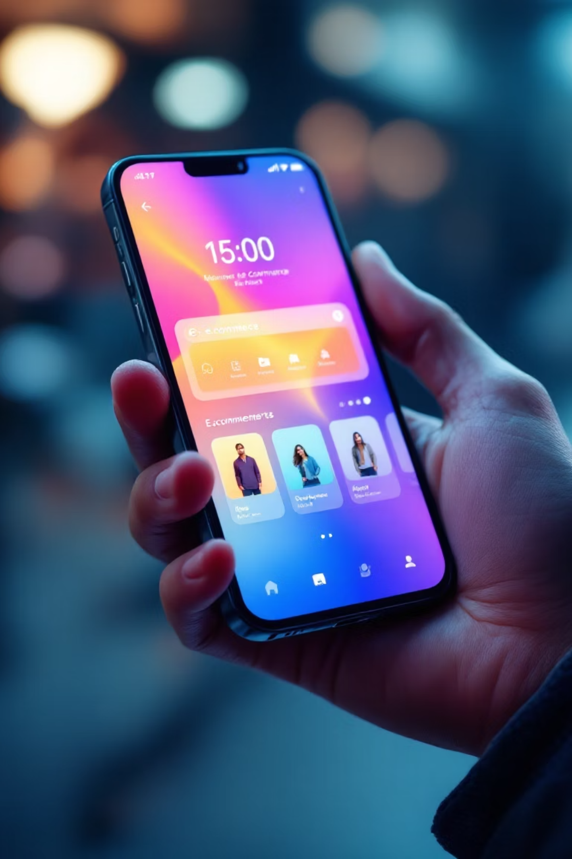




User Interface and Experience Design
Our design philosophy focuses on creating an intuitive, visually appealing, and highly functional mobile shopping experience. We aim to convert browsers into buyers through thoughtful design choices.
Intuitive Navigation
Effortless browsing with clear categories, intuitive menus, and a well-organised layout for quick product discovery.
Clean & Minimalist Design
An uncluttered interface reduces visual noise, making product presentation sharp and shopping enjoyable.
Personalised User Flows
AI-driven recommendations and adaptive layouts deliver a unique shopping journey for every user.
Engaging Interactions
Subtle animations, haptic feedback, and smooth transitions enhance engagement and create a delightful experience.

Slide 5

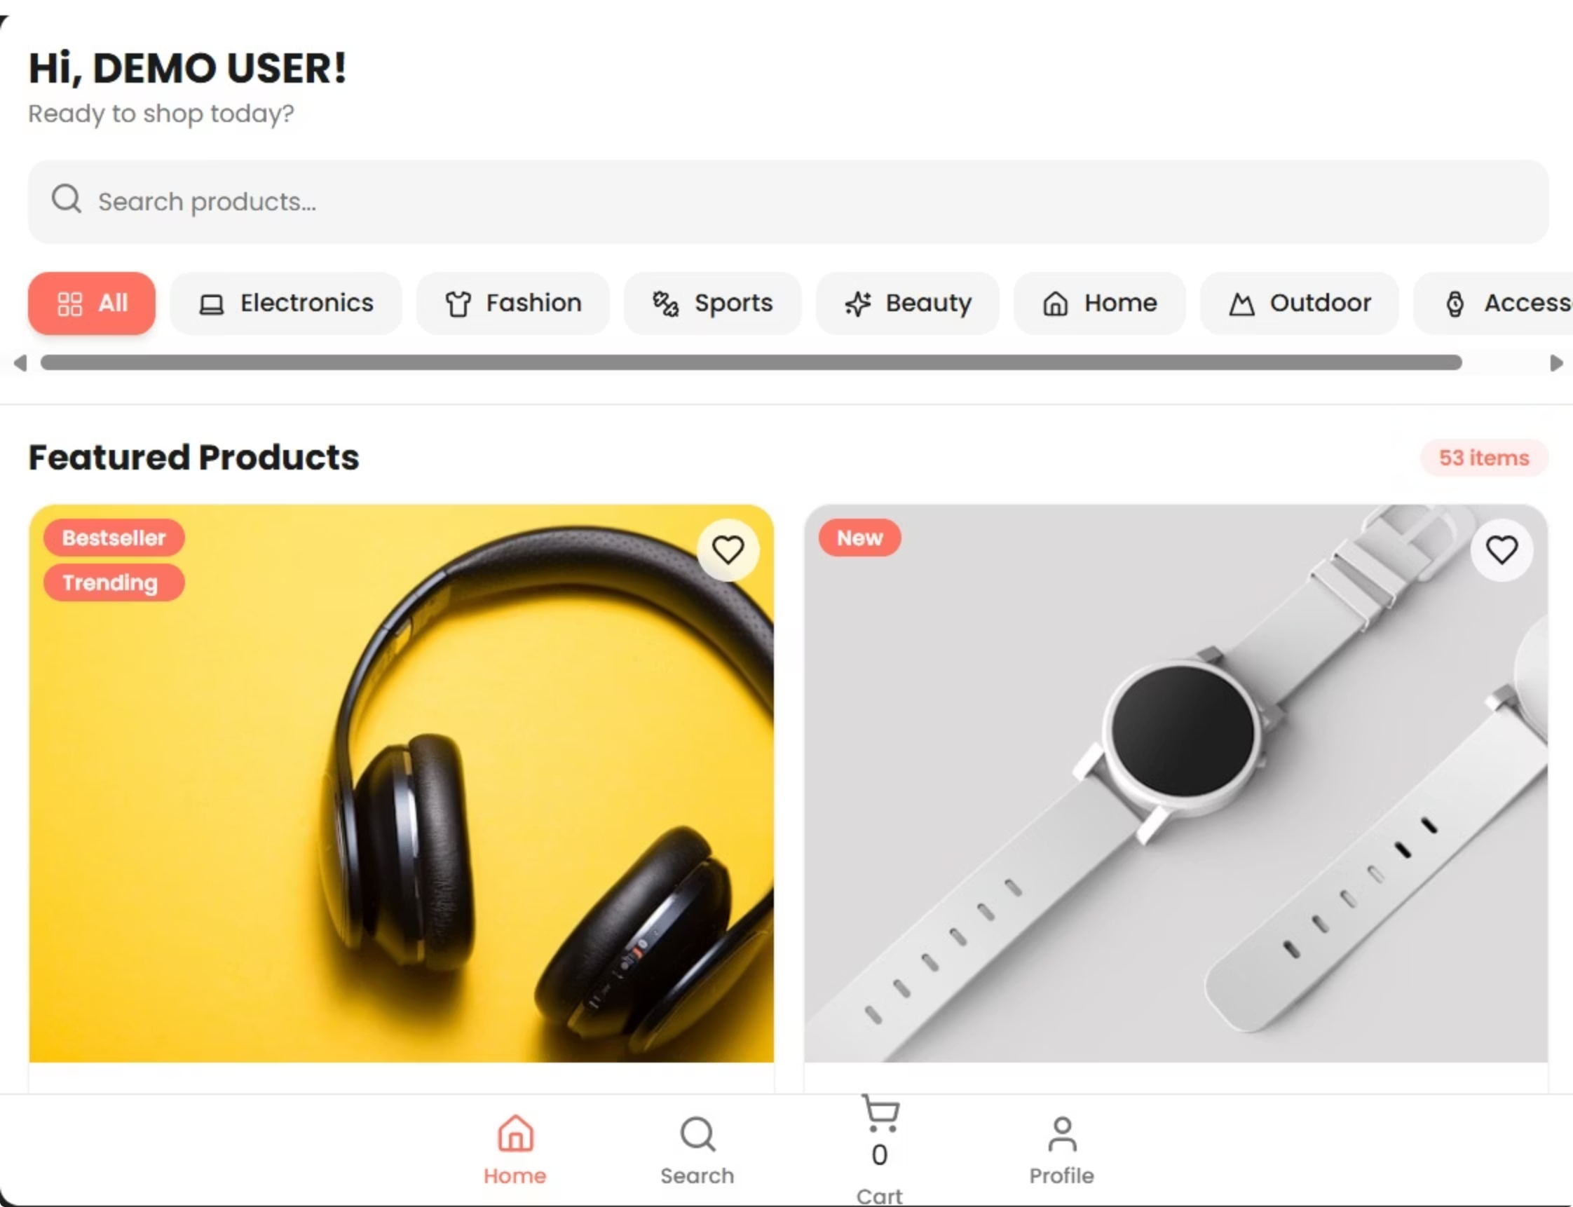
User Interface and Experience Design
01
User Interface (UI) and User Experience (UX) design work together to create products that are both beautiful and easy to use.
UI Design focuses on how a product looks — colors, buttons, icons, and layouts.
UX Design focuses on how it feels — the user’s journey, satisfaction, and overall interaction.

Slide 6
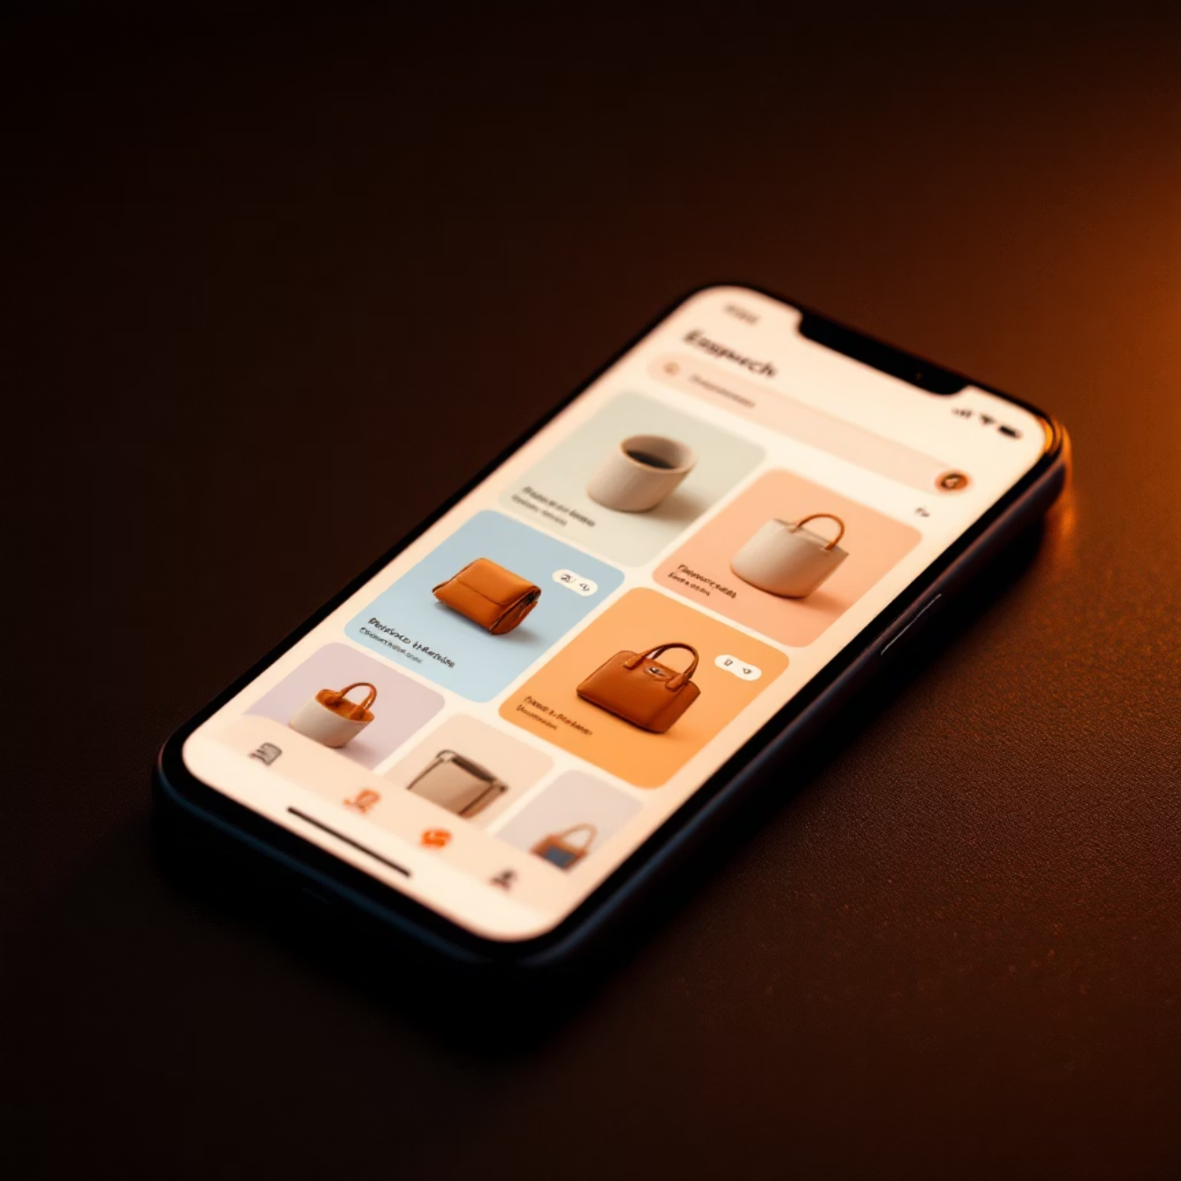
Product Catalogue and Search Capabilities
Intelligent Catalogue Management
Our robust product catalogue system organises thousands of items across multiple categories with hierarchical navigation and dynamic filtering options.
Multi-level category structure with breadcrumb navigation
Advanced filters by price, brand, ratings, and attributes
Sort options including relevance, popularity, and price
Quick view functionality for faster browsing
Smart Search Features
Machine learning algorithms power intelligent search with auto-complete, spell correction, and contextual suggestions that improve with each user interaction.
10K+
<2s
95%
Active Products
Search Speed
Search Accuracy
Diverse catalogue across categories
Lightning-fast results delivery
Relevant results on first try

Slide 7


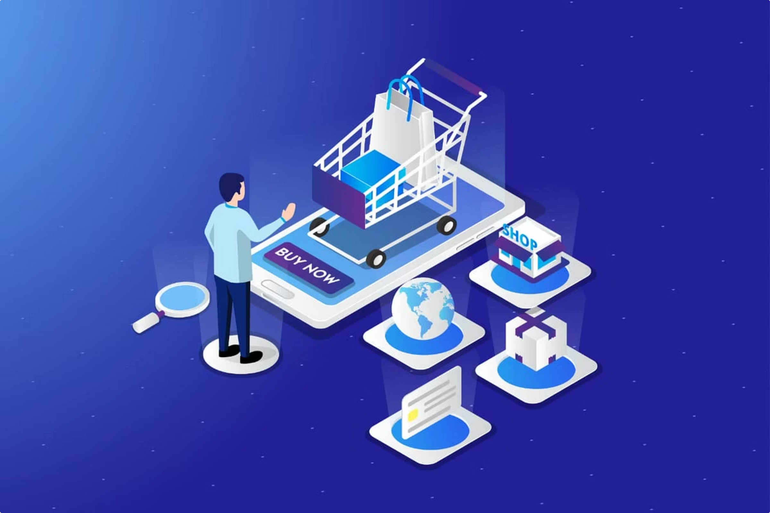



Shopping Cart and Checkout Process
Add to Cart
One-tap addition with quantity selection and variant options. Real-time stock updates prevent disappointment.
Cart Review
Easy modification of quantities, removal of items, and application of promo codes with instant price calculations.
Address Selection
Saved addresses, Google Maps integration, and address validation ensure accurate delivery information.
Order Confirmation
Final review with estimated delivery dates and instant order confirmation via email and SMS.
Optimised for Conversion: Our streamlined three-step checkout process reduces cart abandonment by 40% compared to industry standards, with guest checkout options and persistent cart functionality across devices.

Slide 8

Payment Integration and Security Measures
Diverse Payment Options
UPI Integration
GPay, PhonePe, Paytm, and all major UPI apps for instant payments favoured by Indian users.
Cards & Wallets
Credit/debit cards, digital wallets, and net banking options with saved card tokenisation.
Cash on Delivery
Traditional COD option with partial payment choices for customer convenience and trust building.
Robust Security Framework
PCI-DSS Compliance: Full adherence to Payment Card Industry Data Security Standards ensuring customer financial data remains protected.
Encryption: End-to-end SSL/TLS encryption for all transactions with 256-bit security protocols.
Fraud Detection: AI-powered systems monitor suspicious activities and flag potential security threats in real-time.

Slide 9
Order Management and Tracking System
Order Placed
1
Instant confirmation with order ID and estimated delivery timeline shared via multiple channels.
2
Processing
Warehouse picks and packs the order with quality checks ensuring product condition.
Shipped
3
Real-time tracking link activated with courier partner details and expected delivery date.
4
Out for Delivery
Live location tracking of delivery executive with contact information for coordination.
Delivered
5
Delivery confirmation with photo proof and instant feedback request for service quality.
Order History & Reordering
Returns & Refunds
Complete order history with filters by date, status, and product category. One-tap reordering of previous purchases makes repeat buying effortless.
Simple return initiation within the app, automated refund processing, and transparent status updates throughout the return journey.

Slide 10
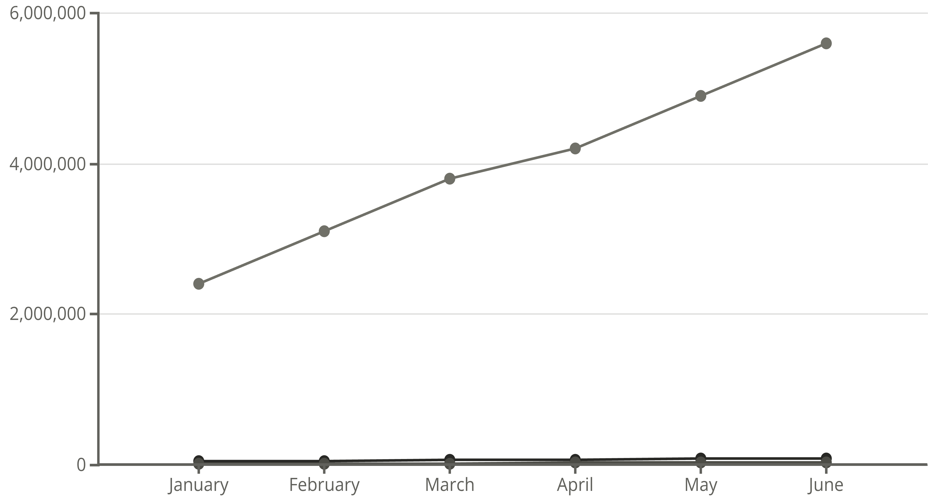




Performance Metrics and Analytics Dashboard
Active Users
Orders
Revenue
32%
4.8/5
Conversion Rate
App Rating
Visitors to paying customers
Average user satisfaction score
65%
2.3s
Repeat Customers
Avg Load Time
Users making multiple purchases
Pages loading speed
Key Insights: Continuous monitoring of user behaviour, funnel analysis, and A/B testing results drive data-informed decisions for ongoing optimisation and feature prioritisation.

Slide 11



Future Roadmap and Enhancement Opportunities
AR Product Visualisation
AI Personal Shopper
Voice Commerce
Augmented reality features allowing customers to virtually try products before purchase, reducing returns and increasing confidence.
Advanced machine learning algorithms creating hyper-personalised recommendations based on browsing history and preferences.
Hands-free shopping with voice commands, integration with Google Assistant, and natural language product search.
Subscription Services
Social Commerce Integration
Introduce subscription models for frequently purchased items with automated deliveries and special pricing.
Regional Language Support
Enable shopping directly through social media platforms with integrated checkout experiences.
Expanding to support 10+ Indian regional languages for broader market reach and inclusivity.
"The future of e-commerce lies in creating seamless, personalised, and immersive experiences that blend technology with human-centric design. Our roadmap focuses on innovation that truly enhances customer value."

